Slide 1
Force problems

Slide 2
Weight

Slide 3
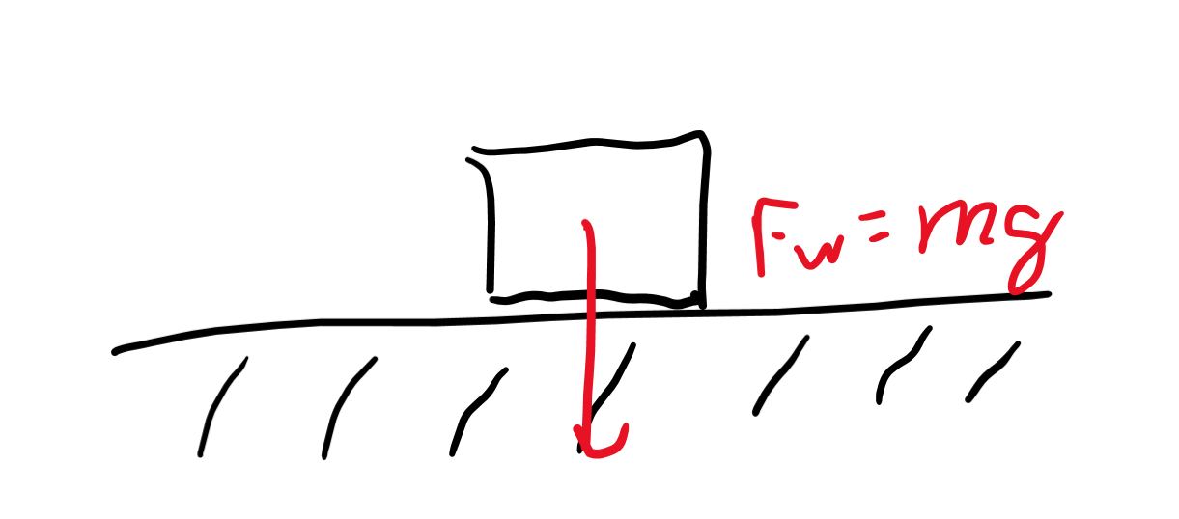
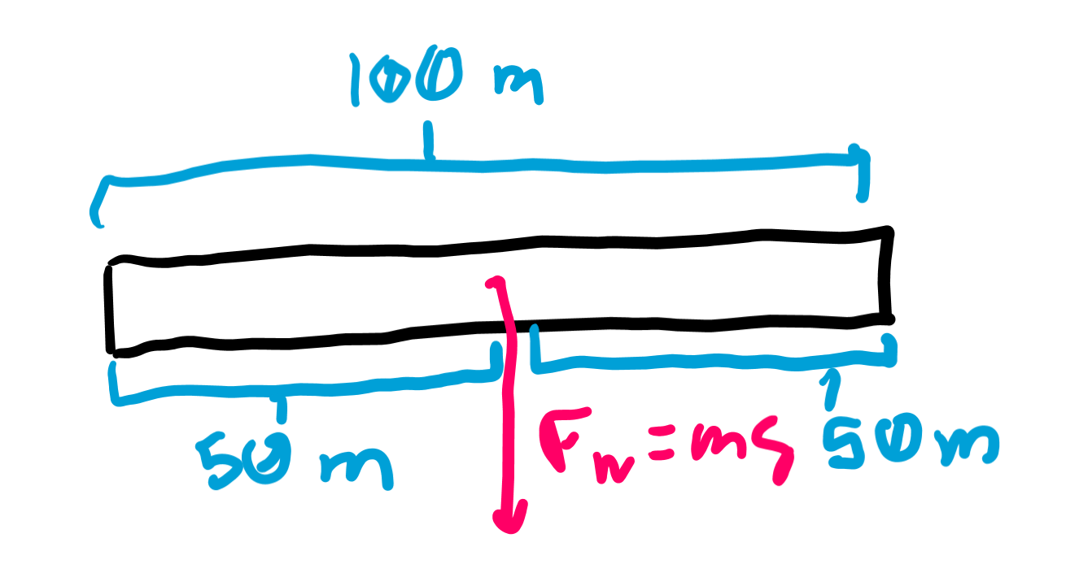
Force of weight
Acts on the center of mass of the object toward the ground (center of mass of Earth).
Magnitude is mg where m is the mass of the object and g is gravitational acceleration.

Slide 4
Normal force

Slide 5
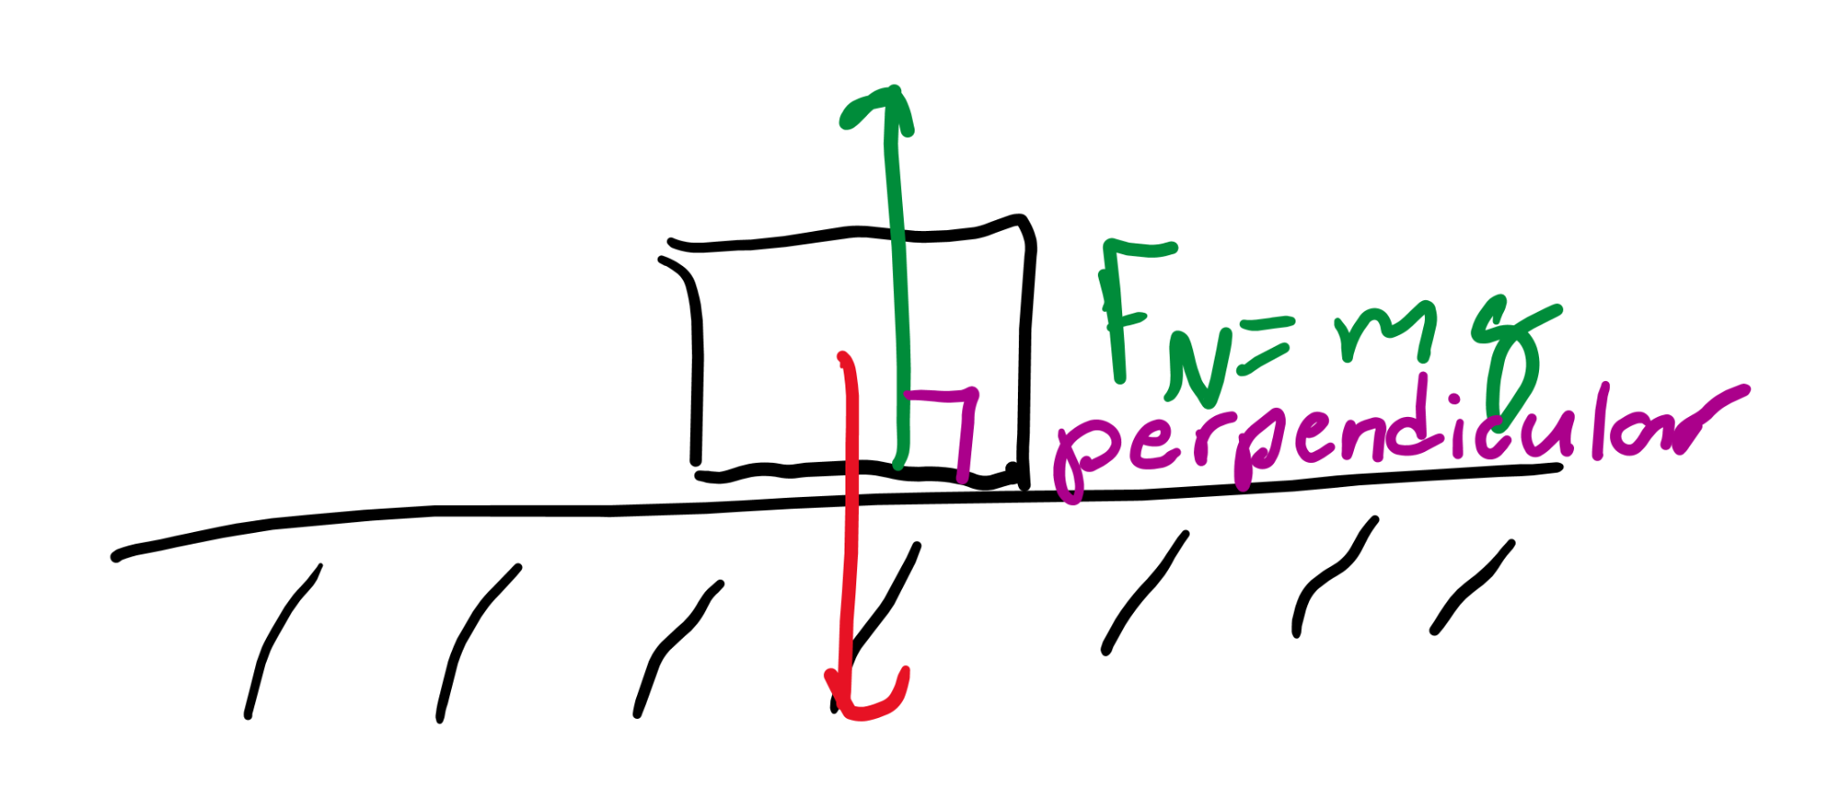
What is it
Normal means perpendicular. This is the force perpendicular to a surface that acts against weight.
There’s a reason we don’t fall through our chairs or the floor: the normal force of our chair acts against our weight.

Slide 6
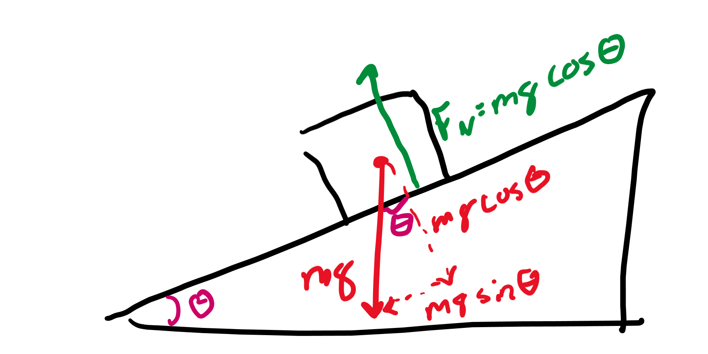
Calculating the magnitude
At different angles, the amount of normal force we have is different. The more tilted the surface, the less normal force there is to counteract gravity.
Normal force on a slope can be calculated as mgcos(θ) where θ is the angle of the slope.

Slide 7
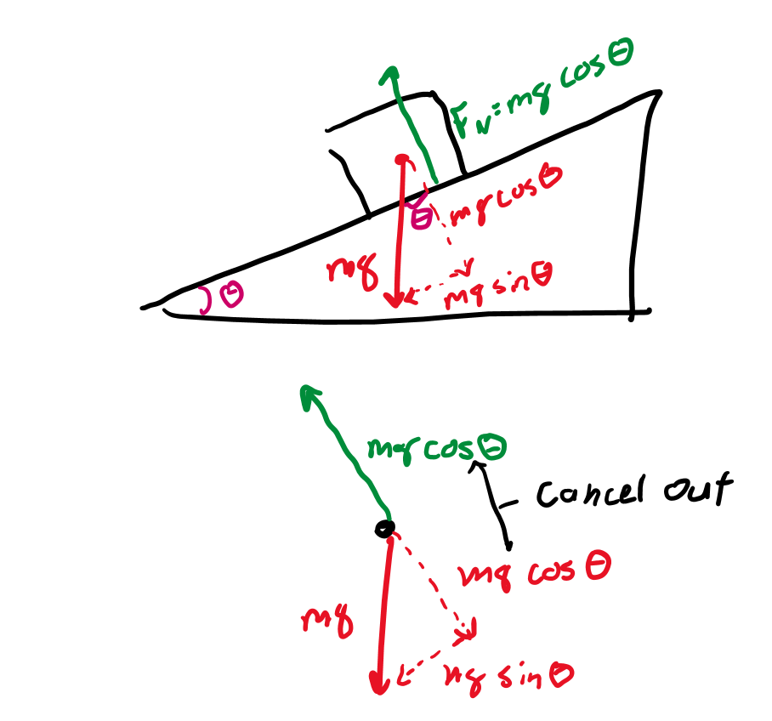
Force on a slope
On a slope, if we draw the free body diagram with normal force and weight, we might notice that there is a net force downward.
This force is mgsin(θ) since it’s the part of the weight that is not countered by the mgcos(θ) of the normal force.

Slide 8
Applied force

Slide 9
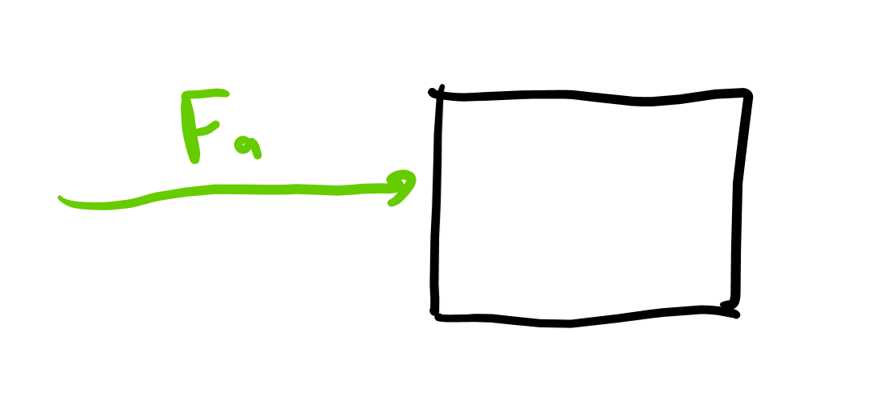
F_{a} = applied force
This is an external force someone or something can apply to an object.

Slide 10
Friction

Slide 11
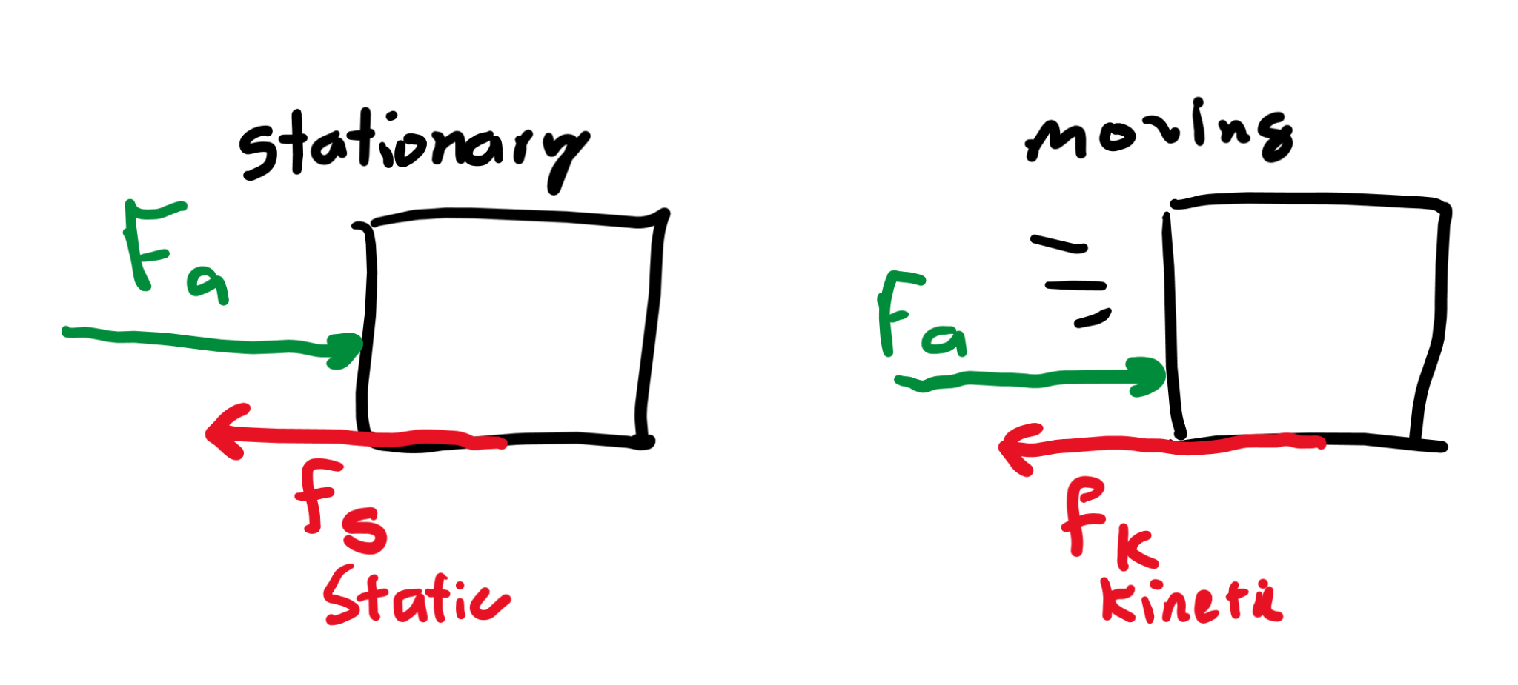
Resisting motion
An object on a slope may not always fall downward though, even though there should be a mgsin(θ) force on it.
This is due to friction, which resists motion.
When an object is not moving, static friction acts on an object. When an object is moving, kinetic friction acts on it.

Slide 12
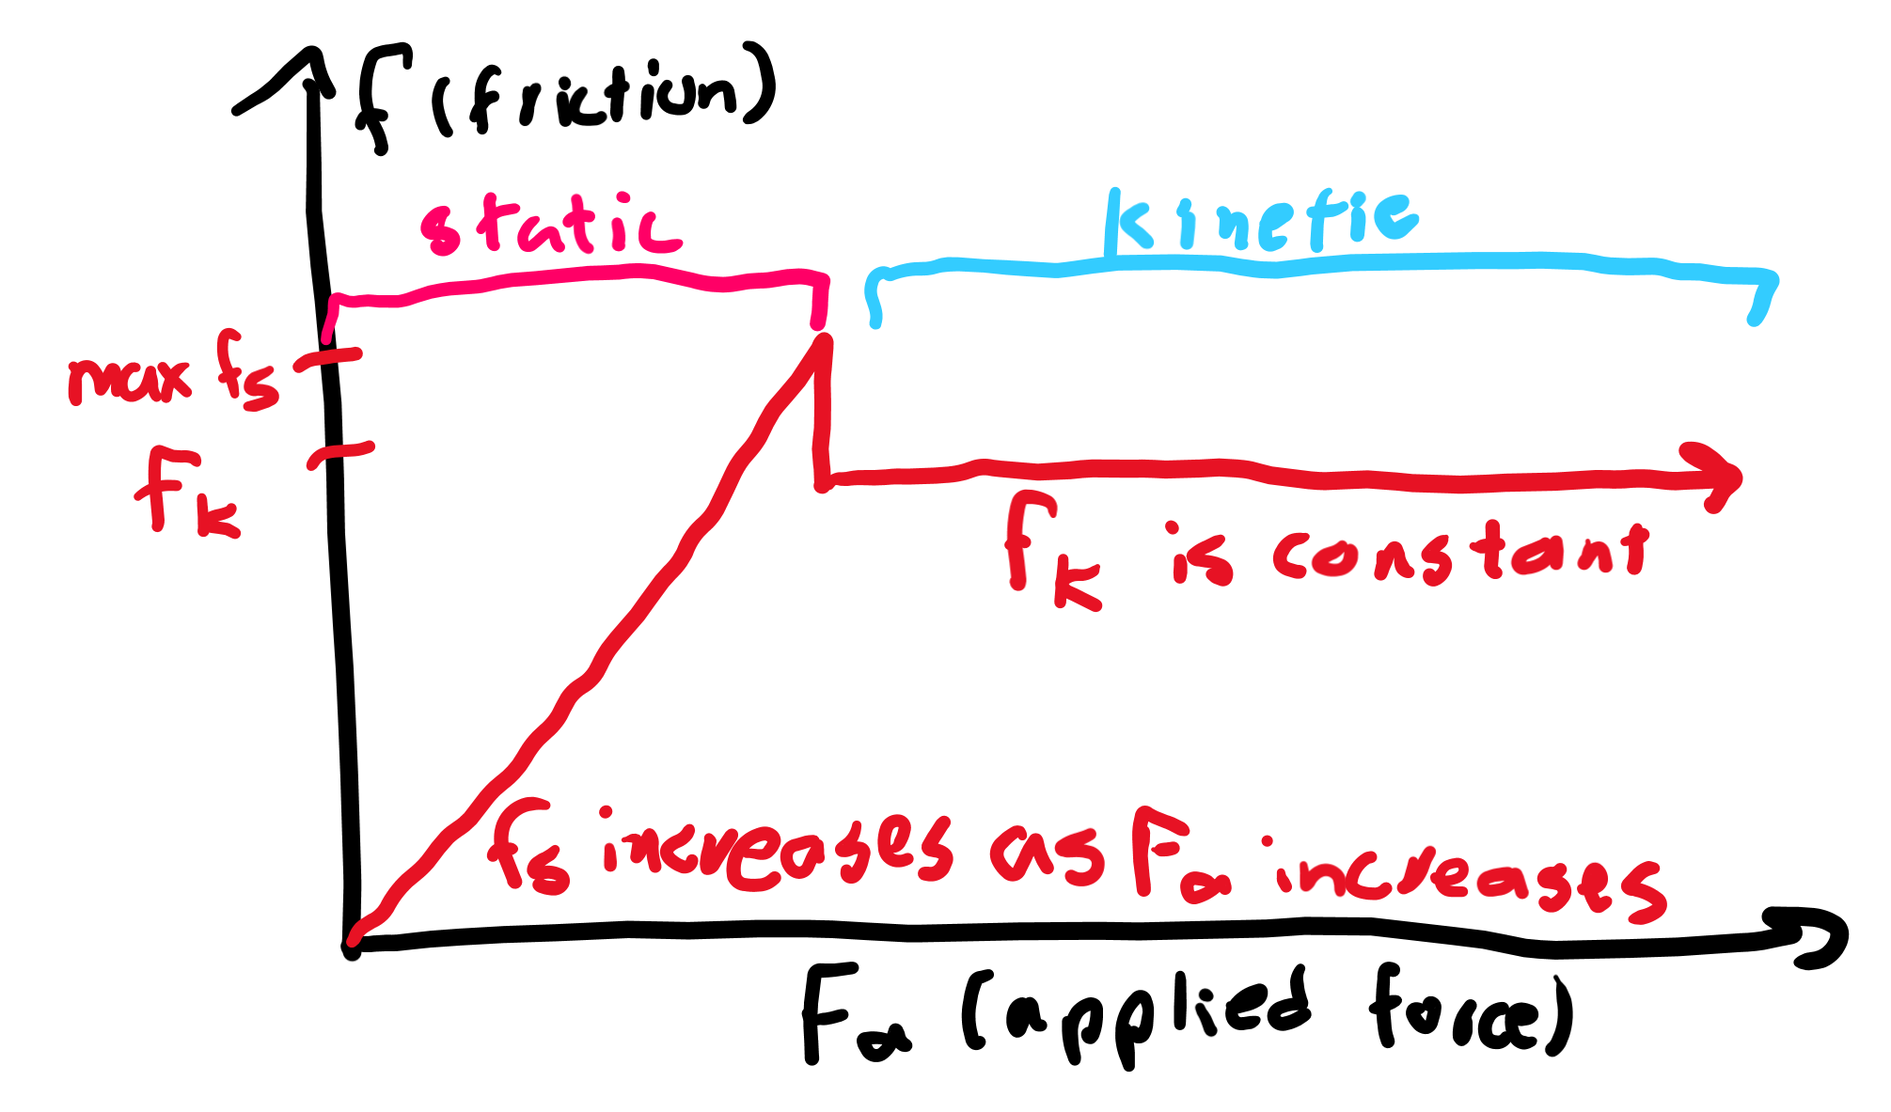
Overcoming friction
Imagine an object with high friction, like a rubber stapler on a desk.
Pushing the object a tiny bit doesn’t move it because static friction increases with the force you apply to prevent motion.
However, once you reach a threshold, the object will suddenly start moving, and now the kinetic friction, weaker than the maximum static friction, will now take effect, acting against the object’s motion.

Slide 13
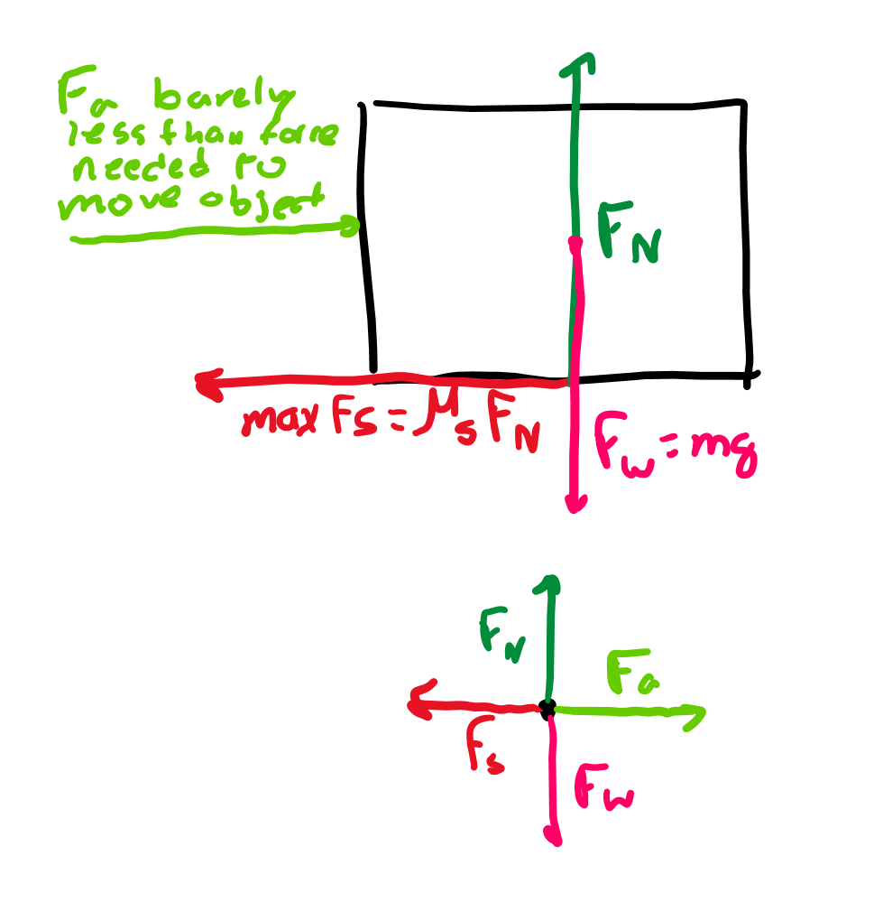
Static friction
All friction is based on the normal force. The more normal force, the more friction.
The expression for maximum static friction is μ_{s}F_{N} where F_{N} is the normal force, and μ_{s} is the “coefficient of static friction,” which is different for every object-surface combination.
Static friction can however be smaller than the maximum as its magnitude matches the forces attempting to get the object to move.

Slide 14
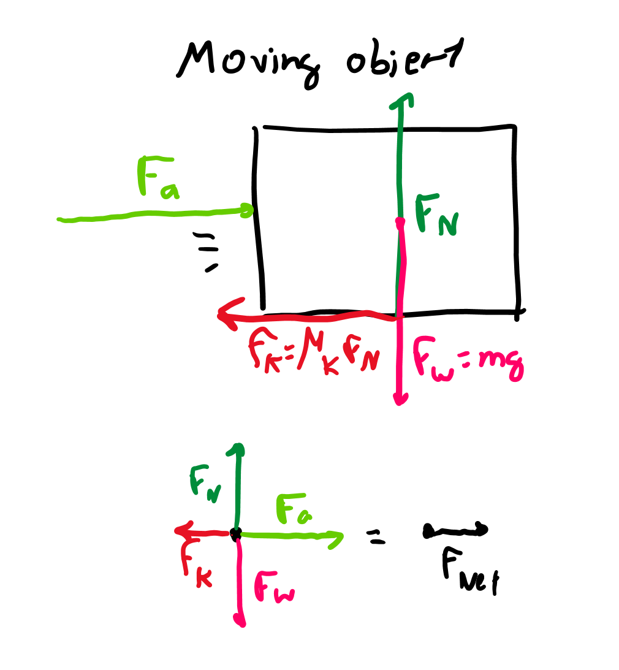
Kinetic friction
Kinetic friction acts against motion, so its direction is opposite to the direction of the object’s velocity.
Each object-surface combo can only have a single kinetic friction which is μ_{k}F_{N}, or the coefficient of kinetic friction multiplied by the normal force.

Slide 15
Net force

Slide 16
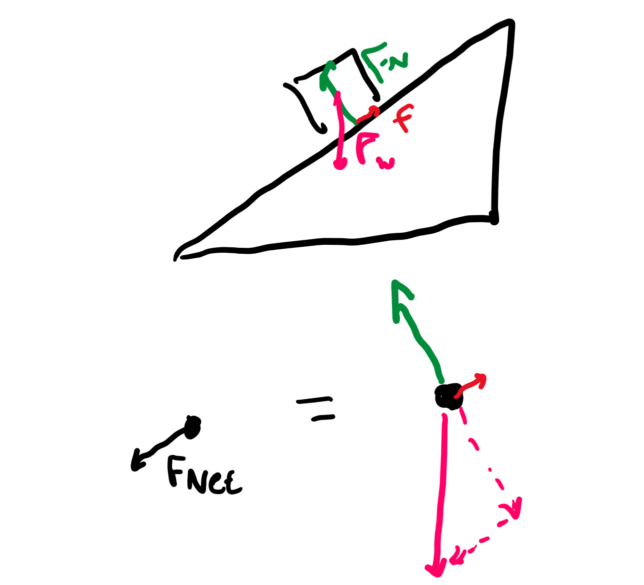
Leftovers
Some forces cancel each other out.
The net force is a single vector that represents the force left over on an object after cancelling out forces that oppose each other (like upward and downward forces or left and right forces).

Slide 17
Tension

Slide 18
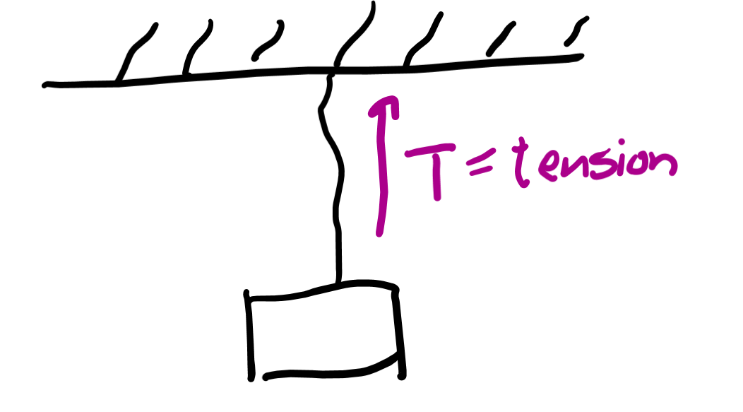
Ropes/strings
The force a rope or string applies to an object is considered the tension on the string.
Tension always acts along the string and we generally assume it’s evenly distributed across the string. (Aka, there isn’t one spot with more tension than another on a string.)

Slide 19
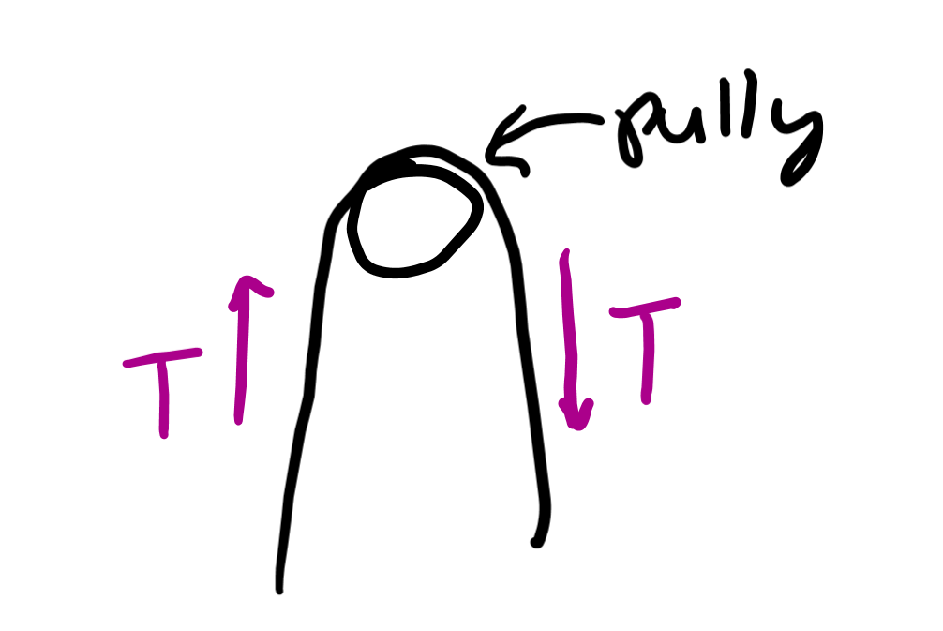
Pulleys
These change the direction of the tension on the string, but the magnitude does not change.

Slide 20
Force problems

Slide 21
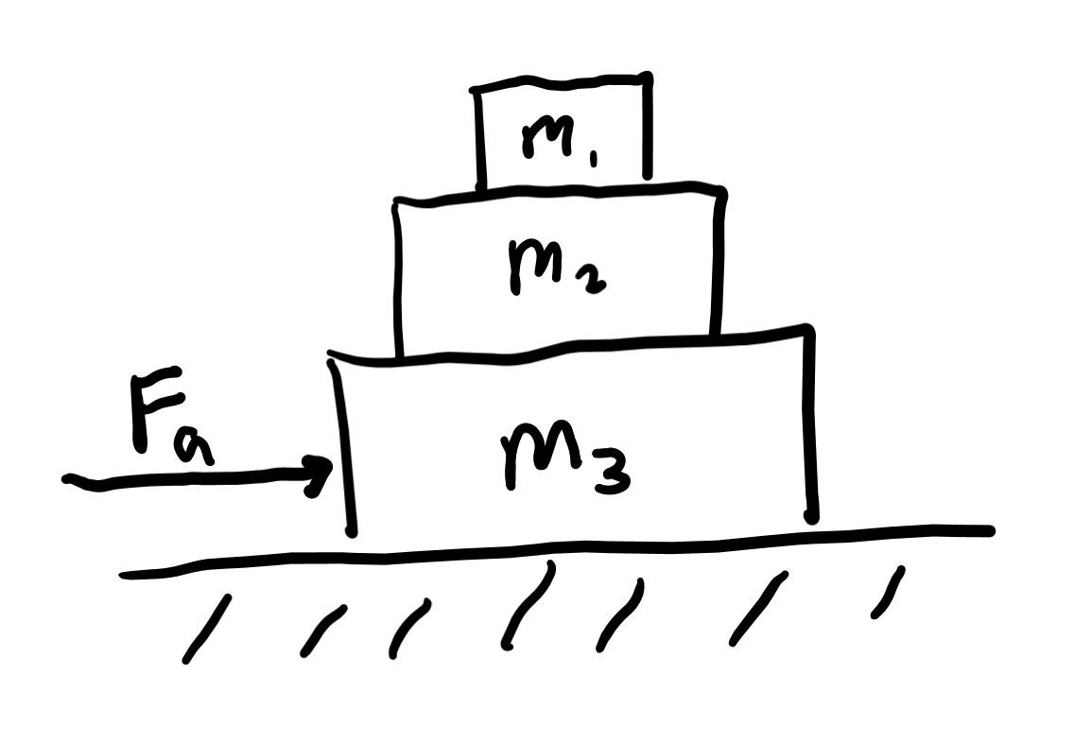
Blocks on blocks
Forces on each block are the weights of the blocks above them pushing down and the normal forces of the surface right below each one pushing up.
If the stack is moving, then static friction between boxes ensure none slide or fall off.

Slide 22
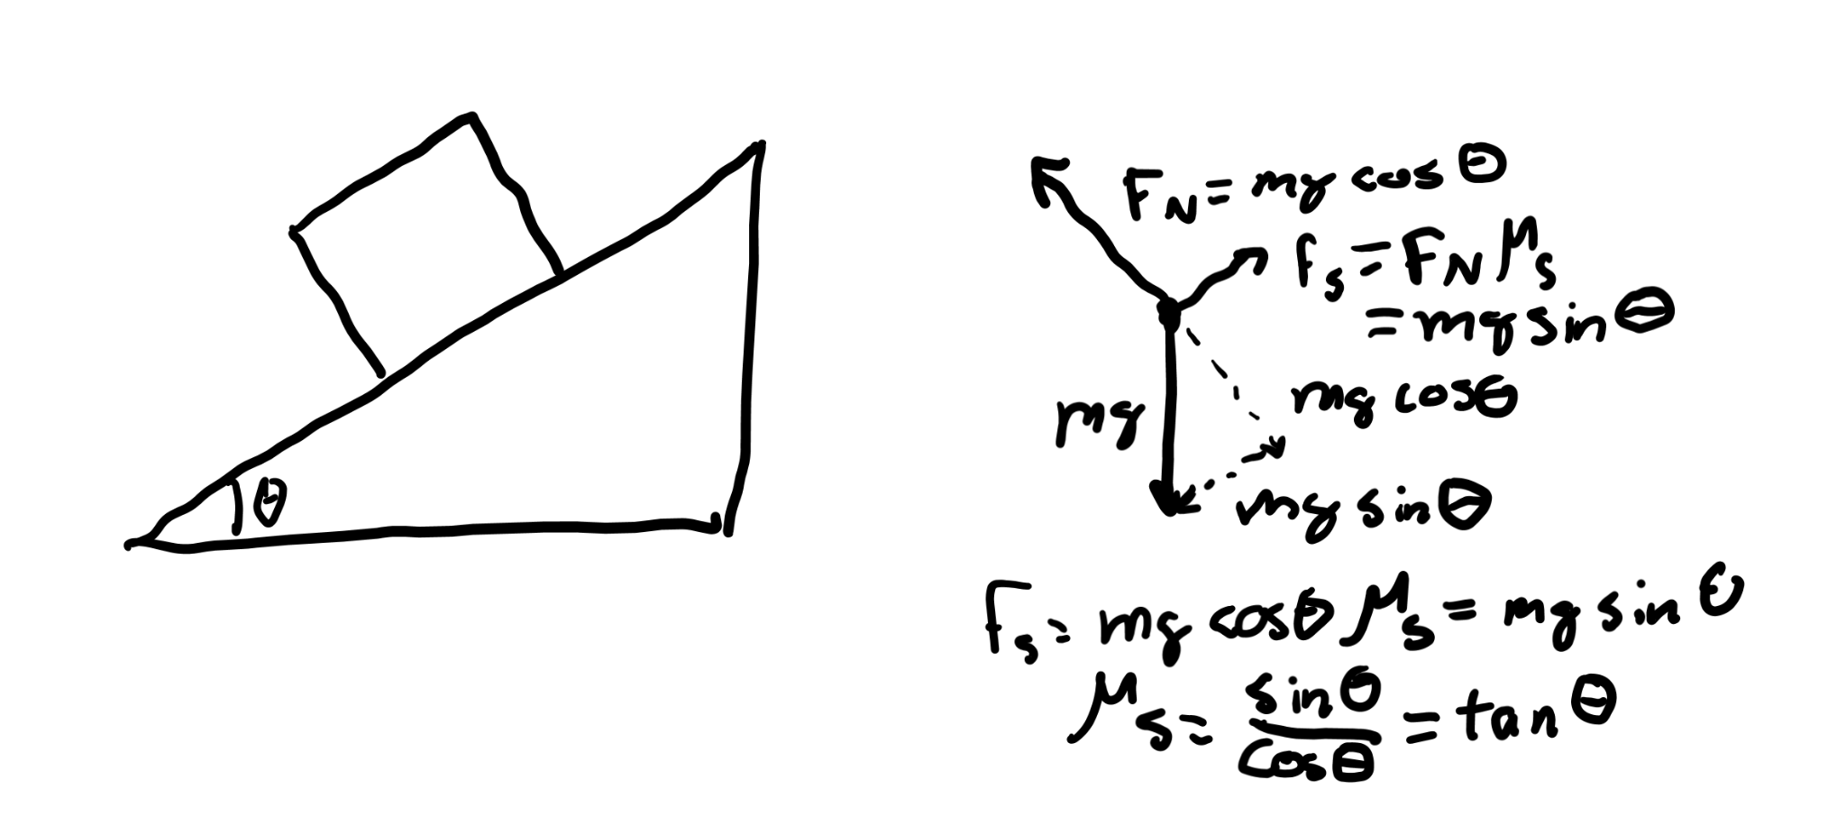
Blocks on inclines
Sometimes the block is stationary on the incline, so you can calculate static friction.
If you’re going to calculate maximum static friction, you’d find the maximum angle θ that doesn’t let the block slip and calculate static friction for that θ.
If the block is slipping down the slope, then the friction you’re calculating for is kinetic friction instead.

Slide 23
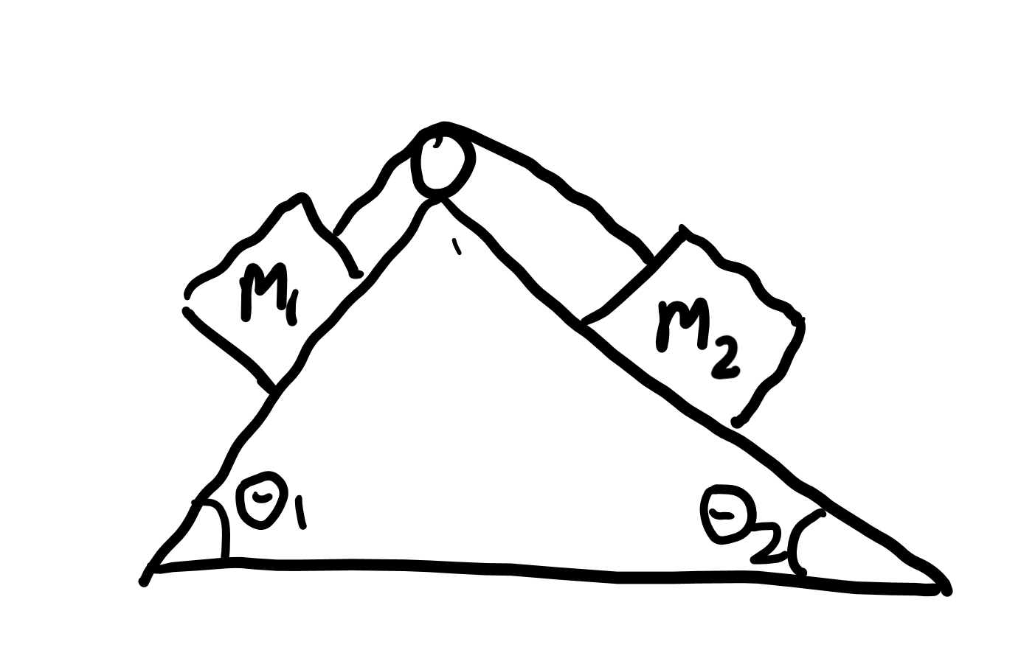
Atwood machines
Forces are the tension of the string pulling each block up and gravity pulling each block down.
Sometimes these are put on inclines, which makes the ropes pull less on each block.
Friction further complicates these types of problems.

Slide 24
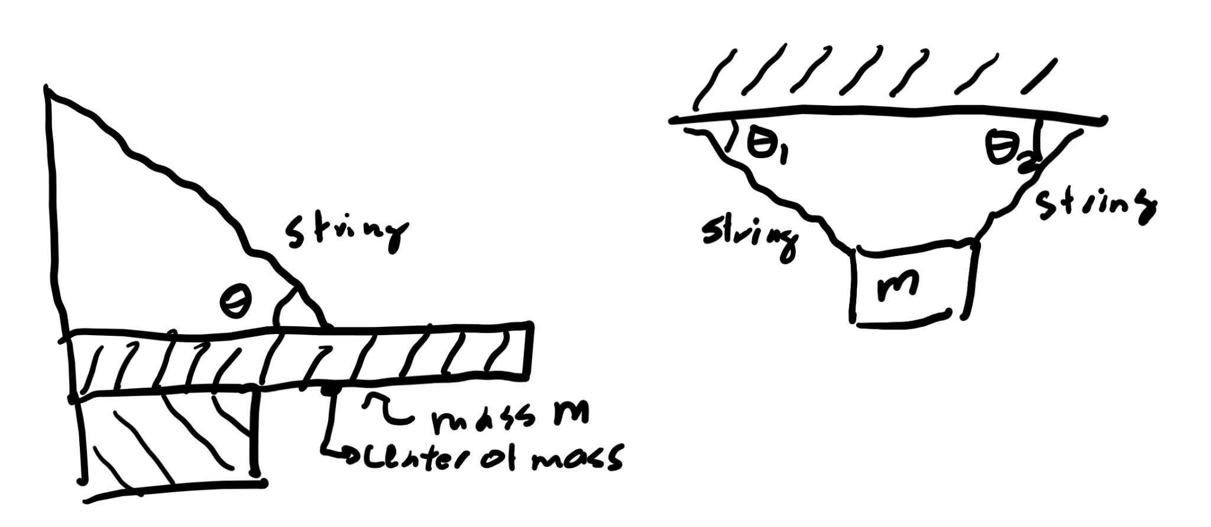
Cantilevers and suspended objects
Tension on a rope counteracts the forces of gravity here. Careful analysis of angles and directionality of forces is required.

Slide 25
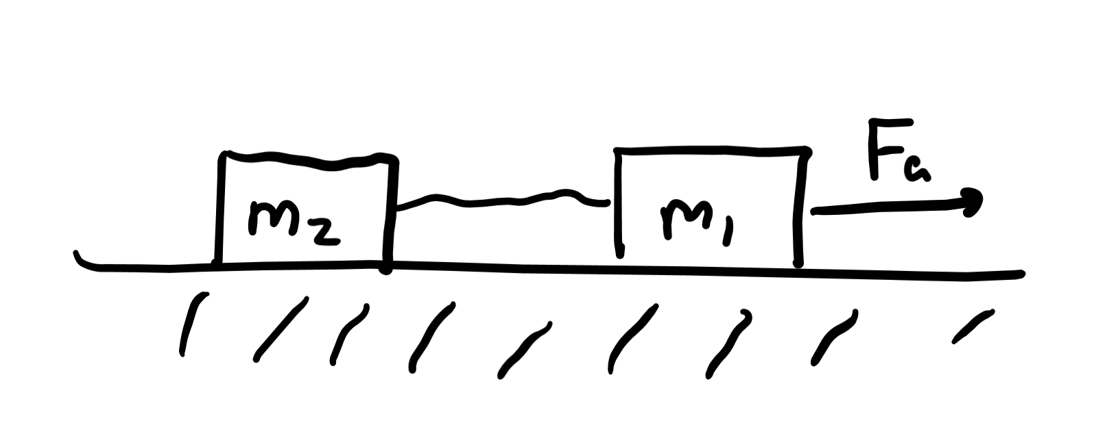
Blocks pulling blocks
One block is manually accelerated. The others are pulled by the tension of a rope.
The hard part is calculating the tension on each rope used to pull other blocks.
The key idea is all the blocks are accelerated the same amount when a force is applied on the system.

Slide 26
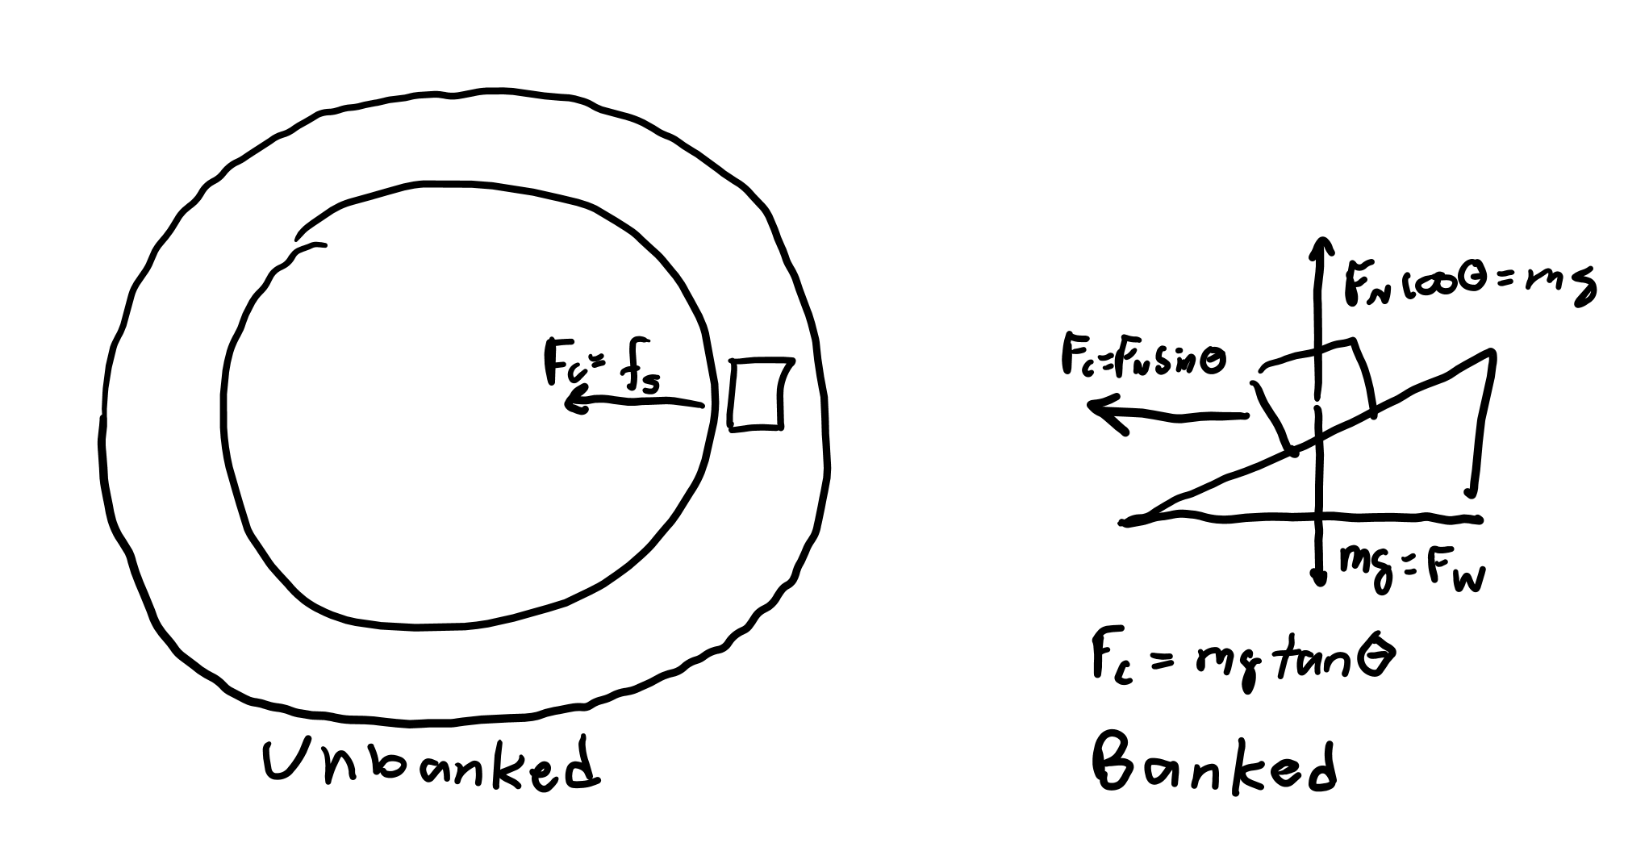
Curves
If a car is going in a circle during a turn, a centripetal force must be applied. If the curve is flat, that means that friction must be preventing the tires from slipping away. Thus, the friction applied on the tires is static.
If the curve is banked (at an angle), the normal force contributes to the centripetal force. For a certain velocity, the normal force is exactly enough to sustain circular motion and no friction is needed.

